Slide 1
Photographic Forensics Identifying People and Dates
David F. Lahrmann

Slide 2
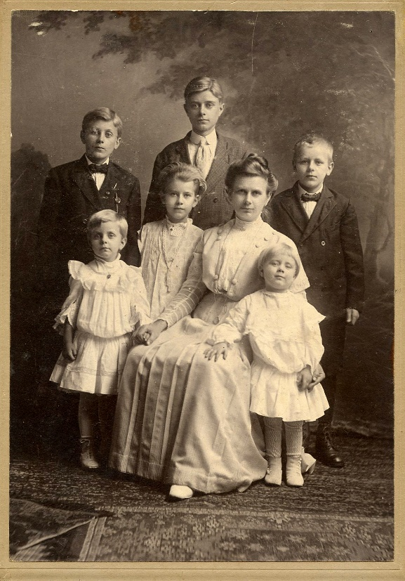
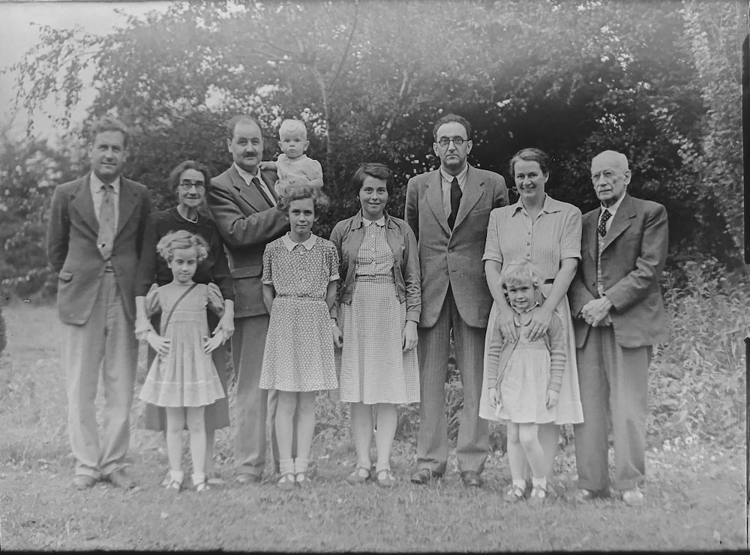
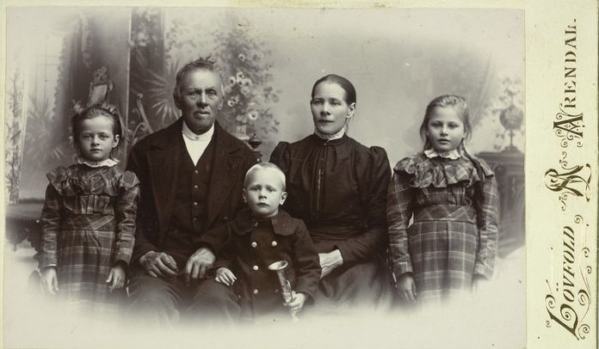
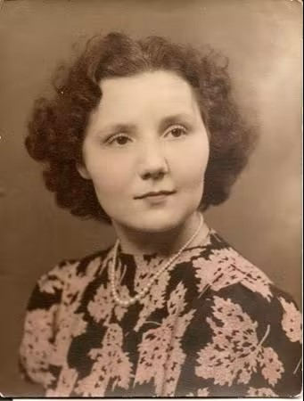
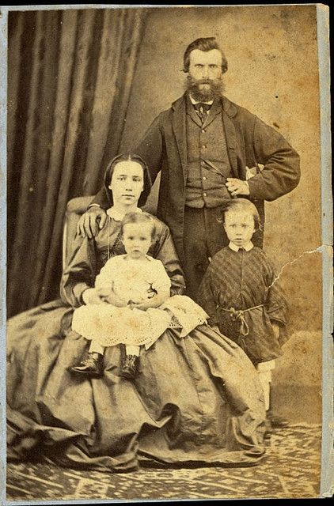
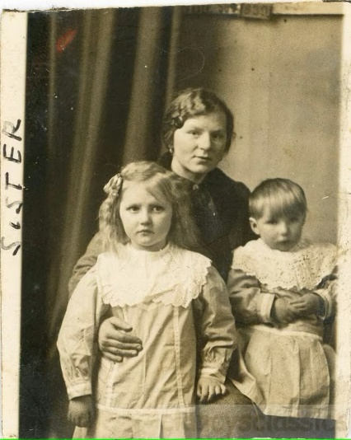
Old Family Photographs
They were taken long before your time
You may know a few people… or maybe no one… but its family
Nothing is written on the photo.. No date… No names
Maybe all are dead now and you know of no one that knows them
There is no way to identify the people in them
What do I do with them?

Slide 3
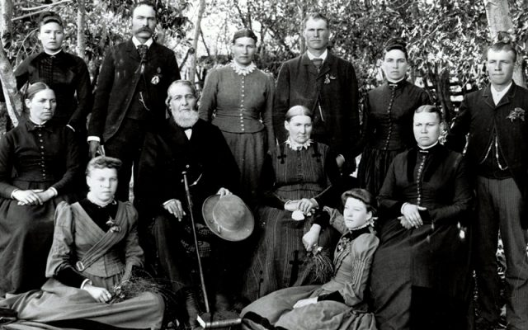
Photographic Forensics
What is it?
Is the process of identifying people in your photographs and being able to date the photograph and the location where it was taken
It is a journey that can and will take time but will reward you immensely for your efforts
How does it work?
Organization
Retrieve digital photographs when needed for review
Research
Collect family facts
Determination
Never give up there are clues to every photo

Slide 4
Objective – Identify Who, What, When, Where
People
Who is in the photograph
Occasion
What was the event associated with the photograph
Dates
When was the photograph taken
Location
Where was the photograph taken

Slide 5
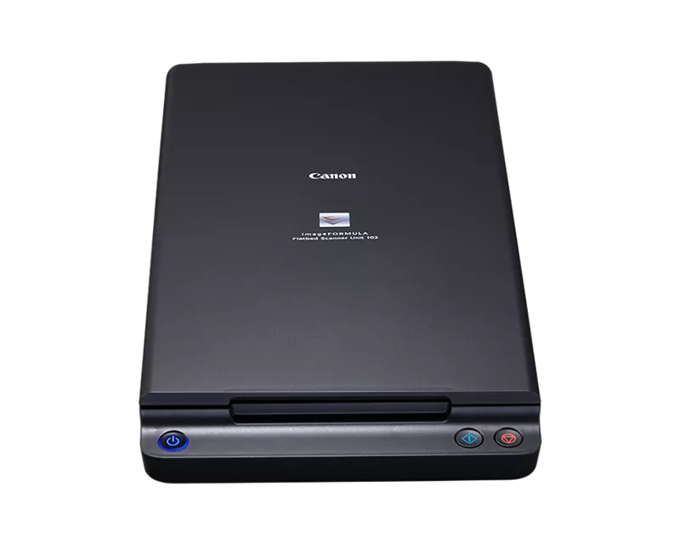
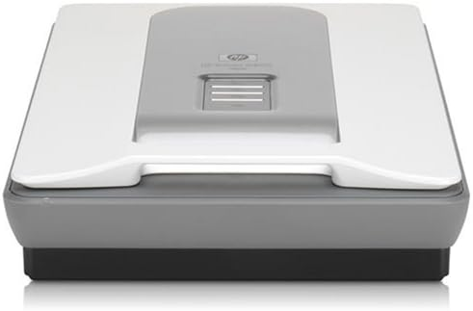
Tools – Computer and Scanner
Computer
Supports scanner and stores images
Scanners
Flatbed scanner for digitizing photographs
Invest in a good one… there are several to pick from
Will depend upon how much you want to spend
Epson
Canon
HP

Slide 6
Collection & Organization
Collect Family Photographs
Collect as many photos as you can
Organize the photographs into potential family groups
Collect Family Facts
Birth and death certificates, marriage license, etc.
They contain facts important to a photograph
Not all facts will be available at one time
Remember it will be a journey
Each new fact adds to the puzzle
There may be a new fact that disrupts the story
Be receptive to information and alternate solutions

Slide 7
Digitization - Scanner
Learn to use the scanner
Master the software settings
Scan a single photo
Experiment using many different settings
Compare the photographs to determine which looks best
Want to control the outcome of the digitized photograph
Digitize photographs
Scan front and back of each photo
Scan them as a JPG (or as a TIFF if planning to edit the photograph)
Scan with at least 300dpi
The higher the better but generally do not need to go over 1000dpi
Assign a unique file name
It is important to create a file naming convention
Want to be able to quickly locate photographs

Slide 8
Digitization – Websites to Visit
https://familytreemagazine.com/preservation/top-10-genealogy-scanning-tips/
https://www.sassyjanegenealogy.com/scanners-for-genealogy-research/
http://www.genealogyintime.com/articles/how-to-scan-old-photos-for-genealogy-research-page1.html
https://thefamilycurator.com/genealogy-scan-along-week-2-scan-your-photos/
https://www.youtube.com/watch?v=AyyenM7OcjU
https://www.youtube.com/watch?v=9eKBkE3RWsU
https://www.youtube.com/watch?v=3yLUvYoMUYI
https://www.youtube.com/watch?v=42gbBxBudxM

Slide 9
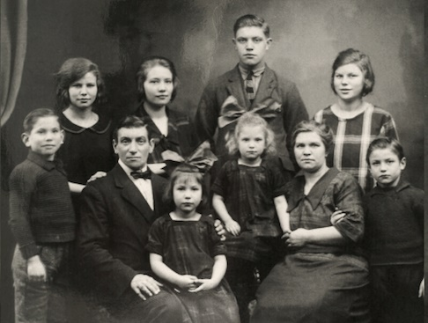
Digital File Organization & Documentation
Important to assign clear file names
Necessary to be able to locate them on your computer
Year, Name, Event
1936, Smith-Jones Family, Christmas.jpg
Place photogrpah into a MS Word document
Document information about the photo as it is collected
Names, dates locations etc.
Use the same file name as the photograph file name
Store MS word document in the same folder as the photograph
For example: 1936, Smith-Jones Family, Christmas.docx for the MS Word document

Slide 10
Photograph Documentation
Thomas Smith
Notes: This is the family photo of the Smith Jones family taken about about 1936. Missing the names of the children except for the oldest boy. Need to find photos with the other children to name them
Edward Smith
Samatha Jones
The objective is to document what you know and can easily modified in the future

Slide 11
Photographic Analysis
Computer Photograph Viewer
Microsoft “Photos” – its free, can view several photographs at one time
Don’t worry about editing the photographs
Pay attention to the details in the photograph
Very important to study the photo
There are many, many, clues and they will be needed
Will not fined or see them all at one time
Use computer screen to enlarge and review photographs
Looking for specific details
Look for differences and commonality in the details

Slide 12
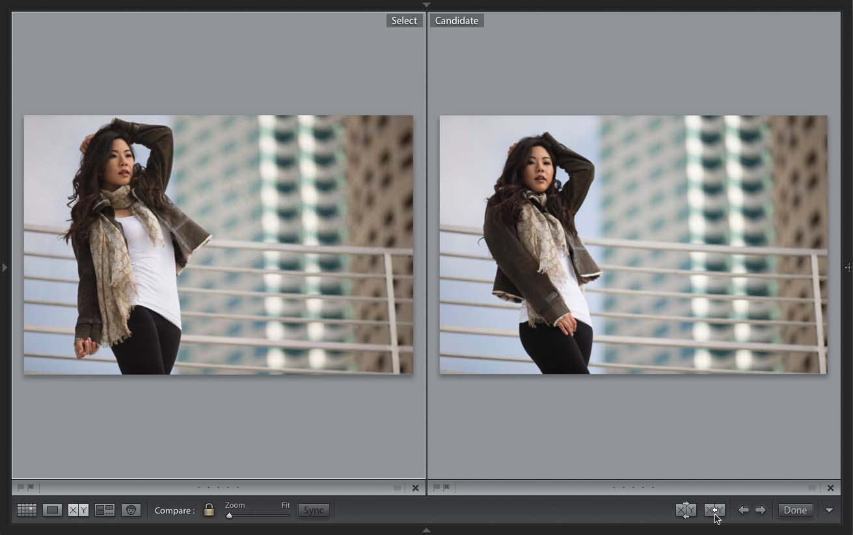
Why it is Important to Digitize the Photo?
Enlarge Photographs
Ability to observe the details in the photograph
Concentrate on specific features
Compare Details
Between two or more photographs at one time
Examine a particular feature in the photographs
Make connections
Determine information needed to complete the story

Slide 13
Details in the Images
People Details
Shape, Position, Distance
Faces
Eyes, nose, lips, ears hairline, eyebrows, chin, cheeks
Body
Hands, fingers, height, body shape, neck, rings,
Clothing
Background Details
And foreground details
Objects
Buildings, structures, monuments
Location
Google Maps has photoggraphs
Objective: Identify Who, What, When, Where

Slide 14
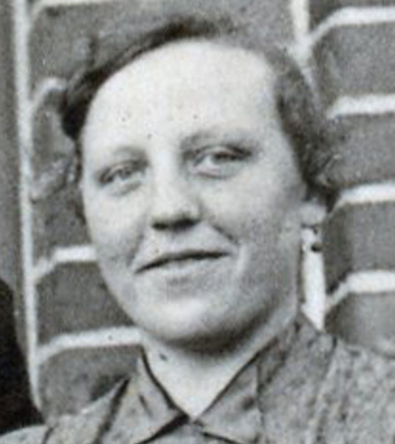
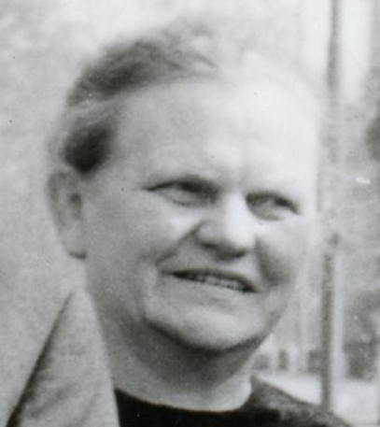
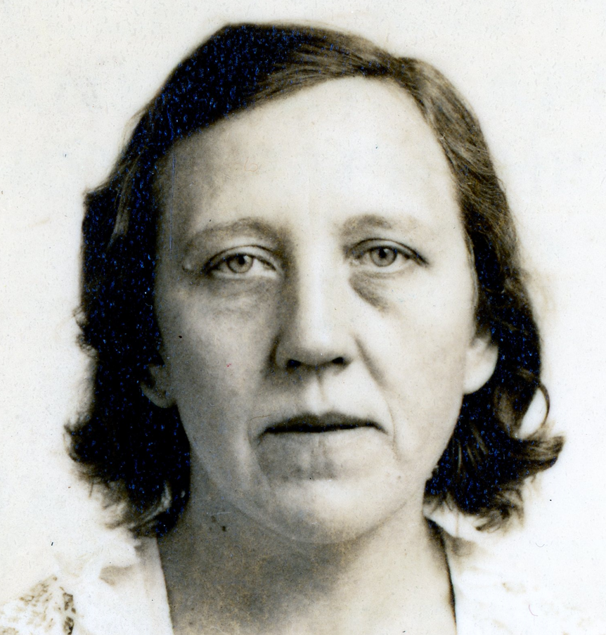
Details - People
Are these the same woman?
Look for details to differentiate

Slide 15
People Facts
Birth certificates
Baptism documents
Marriage records
Divorce records
Death certificates
Burial records
Naturalization records
Property records
Passenger lists
Wills
These documents will be used to help identify people and date a photograph
Objective: Identify Who, What, When, Where

Slide 16
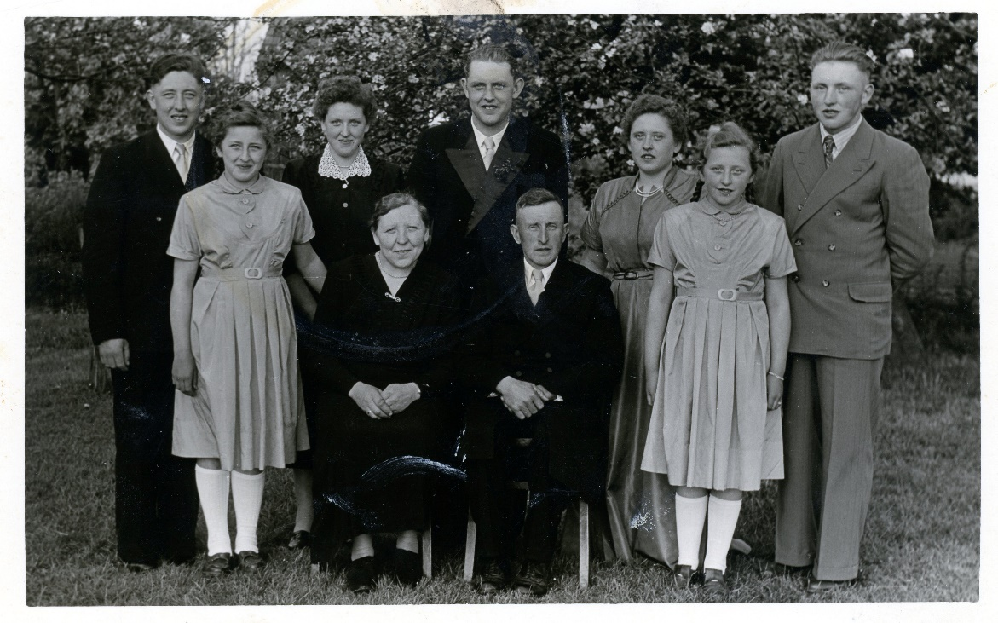
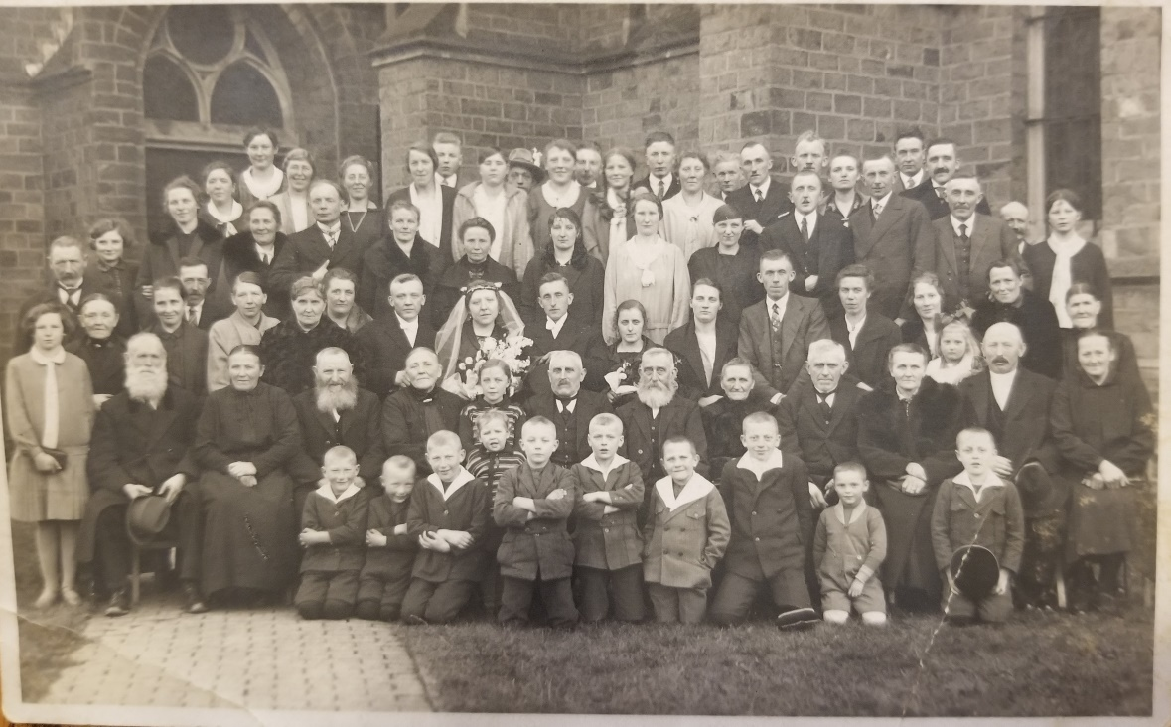
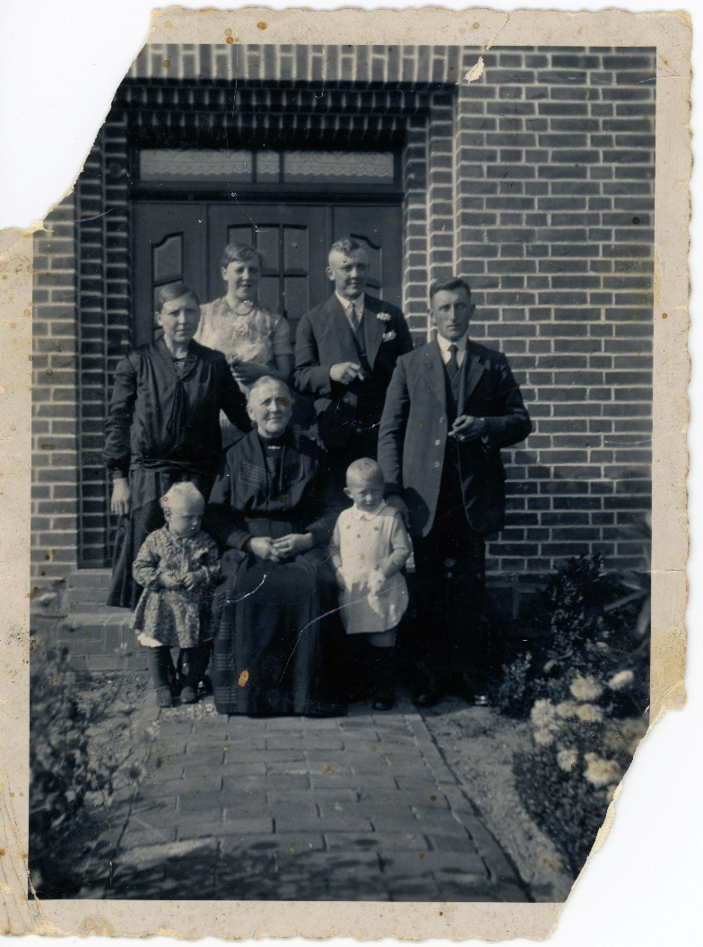
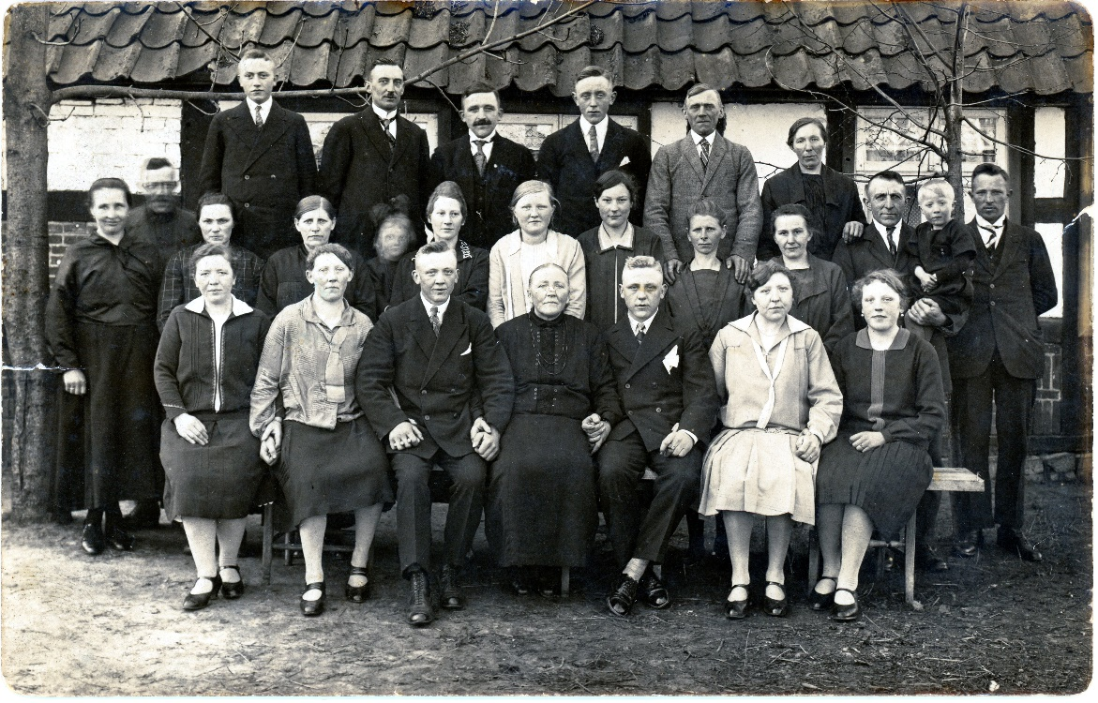
Family Photos - Examples
First Step,
Take a guess at Who, When and Where

Slide 17
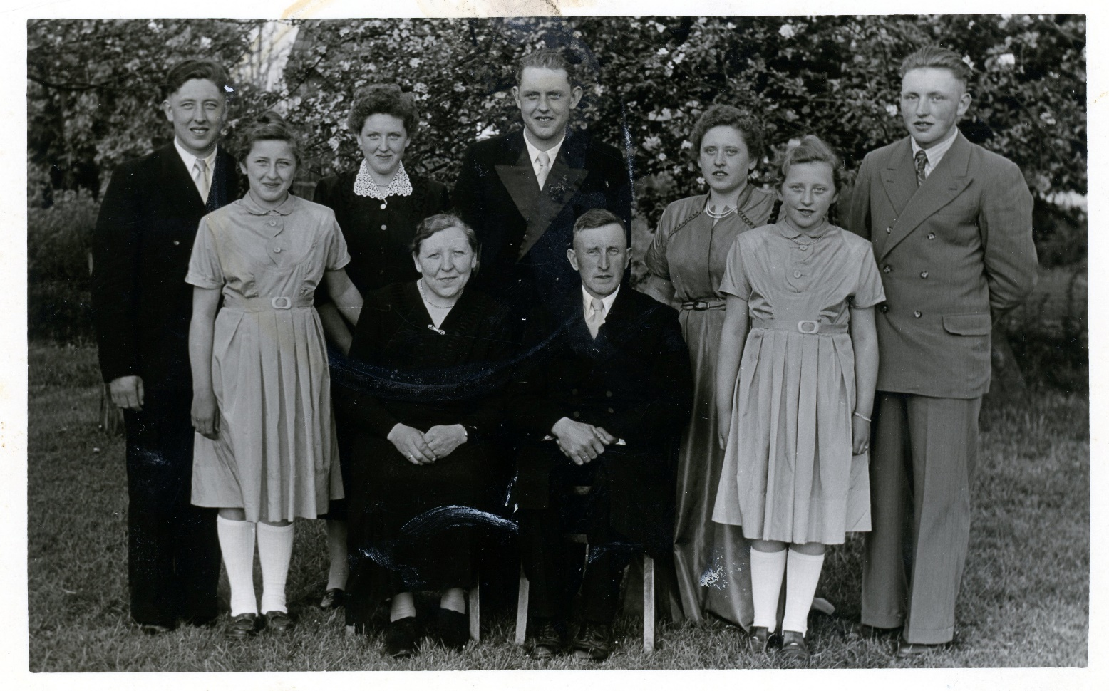
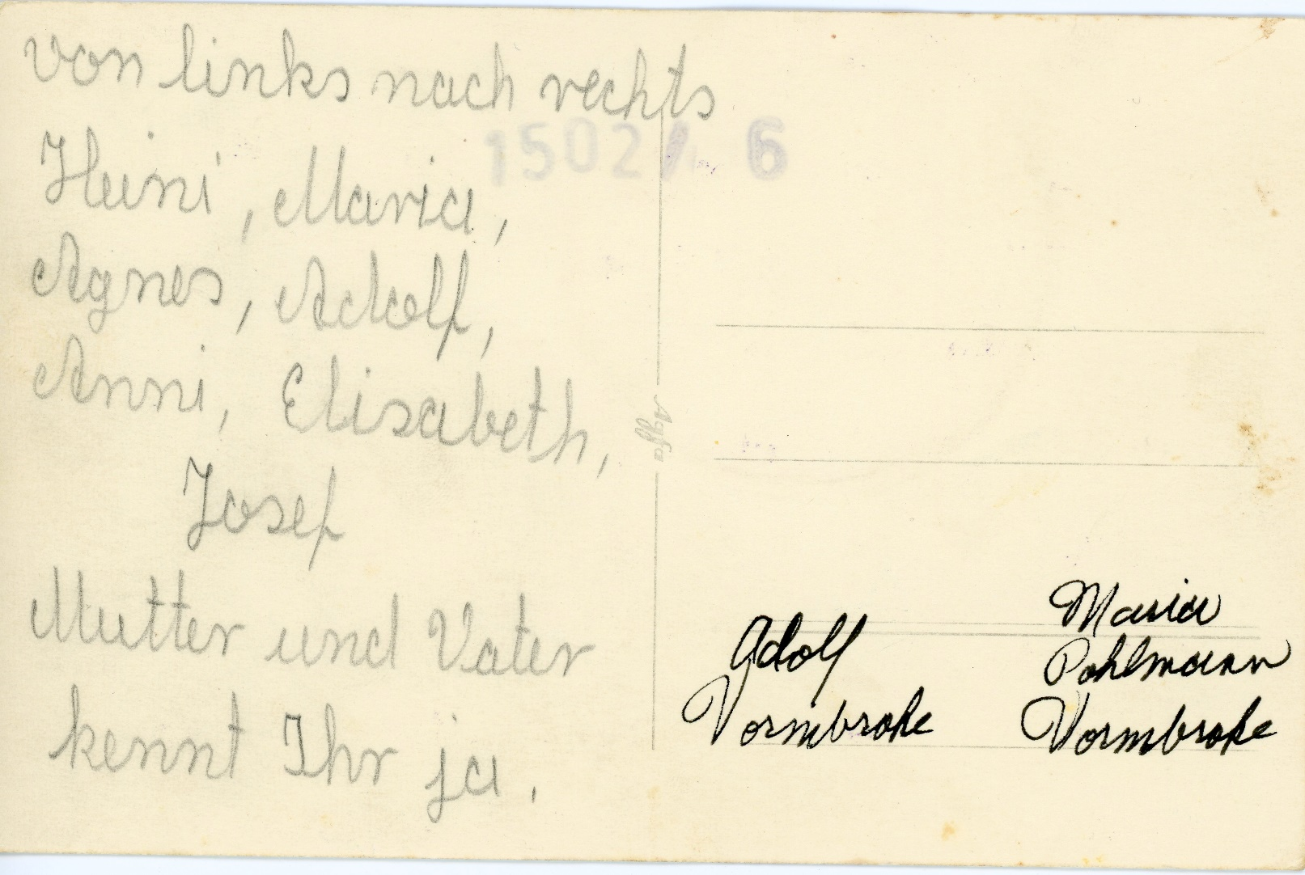
Scan Front and Back of Photos
Family Photograph with names on the back

Slide 18
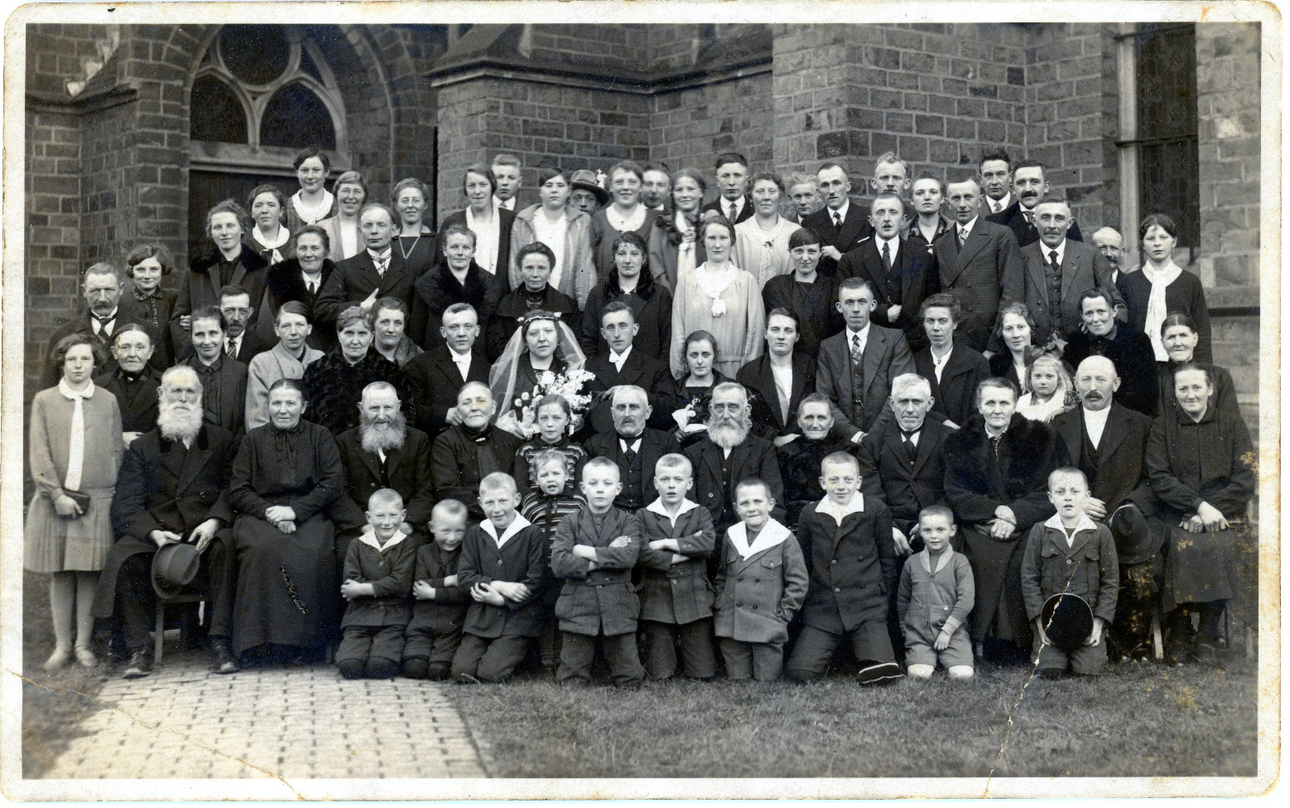
Details – Background & Foreground
Look for details
Beyond the people
What is in the foreground?
What is in the background?
Want to identify the location the photographs were taken
1920s Family Photograph
Look for details to Identify Locations

Slide 19
Details – Background & Foreground
1920s Family Photograph
Recent Photograph from Google Maps
St. Laurentius Chruch in
Neuenkirchen (Hülsen), Germany
Look for details to Identify Locations

Slide 20
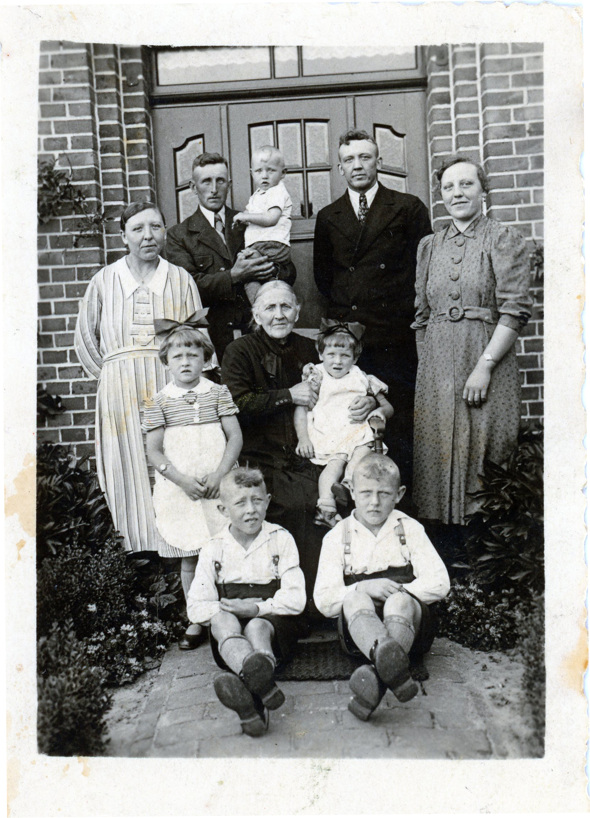
Family Photograph Taken
After 30 Sept 1937
Yongest person in the photo
Appears to be 12 to 18 months old
Before 27 Nov 1939
Oldest person die
Estimate Photo Date
Summer of 1939
Need to find Passenger list for 1939 for Elisabeth Grote
Lady on far right
Lived in United States

Slide 21
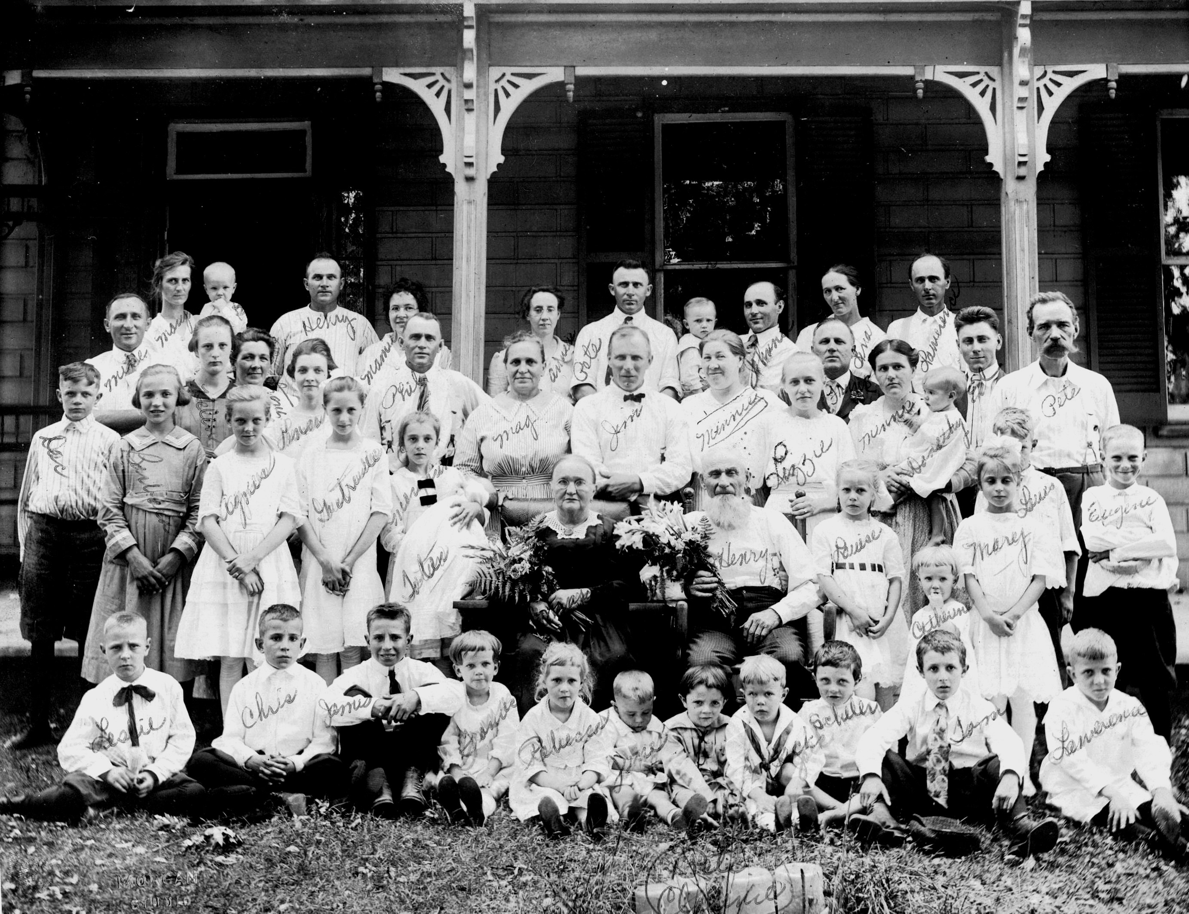
Use Internet Resources
Photos contained in Family Trees in Ancestry.com
Look at other Family Trees as the may have photos

Slide 22
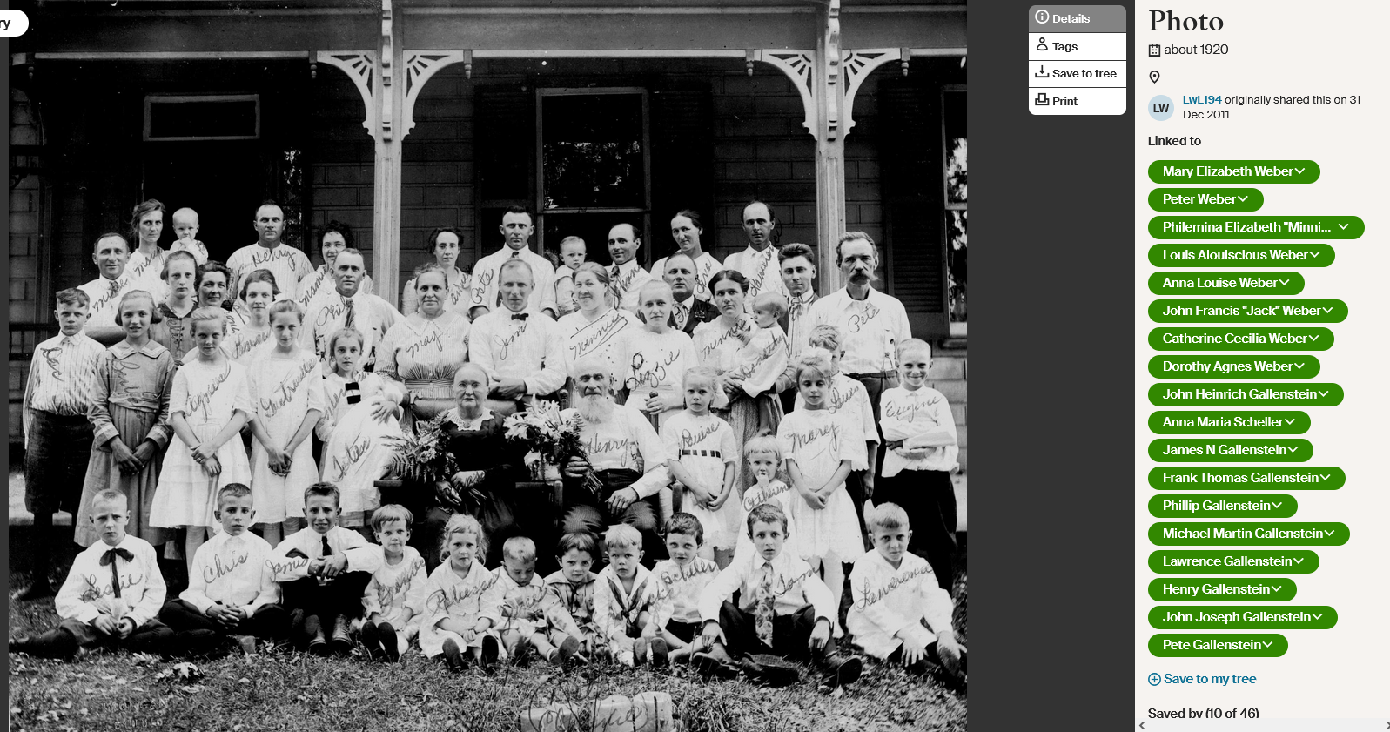

Slide 23
Summary – Photographic Forensics
It is the Process
Establish possible scenarios
Asking questions is important
It is a Journey
Constantly look for clues
It requires Organization, Research, Determination
Objective – Identify Who, What, When, Where
It will reward you immensely for your efforts
Patience Will Bring success!

Slide 24
Enjoy the Journey!

