Slide 1
Beginners' Genealogy Dr. Tom Montgomery, Kolping Member

Slide 2
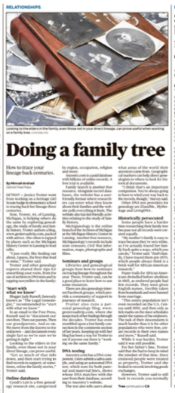
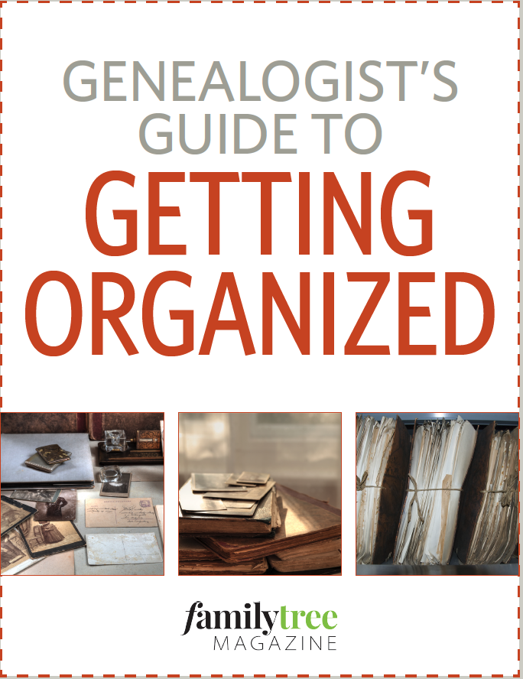
Why?
Your Spark!
Get Organized
Schedule weekly
Collaborate:
Family/Friends

Slide 3
Getting Started
You need to decide a system that you can use.
Binder
Files
Computer
Organize
By individual person
By location
To Do List

Slide 4
Strategies for Research
Little Steps; don’t leap too soon!
Understand the history of your ancestors
Learn the migration patterns of your ancestors
Review your oral traditions and confirm with primary research
Locate records online before reaching out to hire any researcher

Slide 5
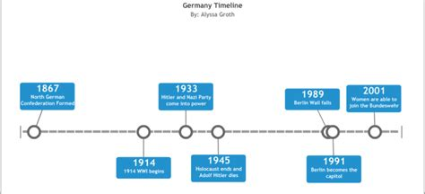
Review History Timelines
Timeline of German history
German History
Germany profile: Timeline
A chronology of key events:
800 - Emperor Charlemagne, Frankish ruler of France and Germany, crowned Roman emperor by Pope Leo III.
843 - Break-up of Frankish empire; Germany emerges as separate realm.
962 - German King Otto I crowned Roman emperor after gaining control of northern Italy; beginning of what became known as Holy Roman Empire centered on Germany.
1250 - Death of Emperor Frederick II Hohenstaufen marks virtual end of central authority and acceleration of empire's collapse into independent princely territories.
1438 - Election of Albert I marks beginning of Habsburg dynasty based in Austria.
1517 - Martin Luther proclaims Ninety-Five Theses against traditional church practices; start of Protestant split from Catholic Church.

Slide 6
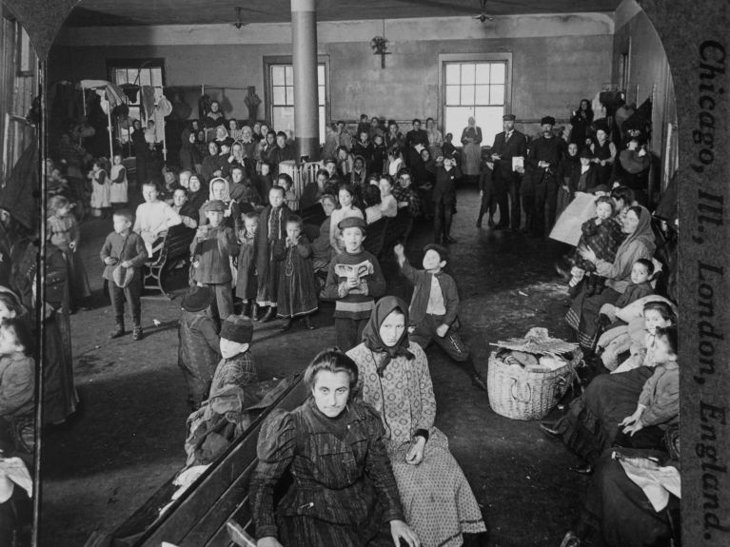
Migration Patterns
Year | Event
1600s | The first German Settlers arrive in the US.
1683 | Over a dozen German Mennonite families settle in Pennsylvania, founding Germantown.
1775 - 1783 | Thousands of German mercenaries are hired by the British to fight in the American Revolutionary War.
1845 - 1855 | Seeking refuge from economic hardship and political strife, over one million Germans immigrated to the US.
1871 | Germany is unified into a state.
1917 | The US joins World War I, and anti-German sentiments spread throughout the country.
1933 | Adolf Hitler comes to power in Germany. Between his rise to power and the end of the World War, over 100,000 Jewish Germans escape to the United States.

Slide 7
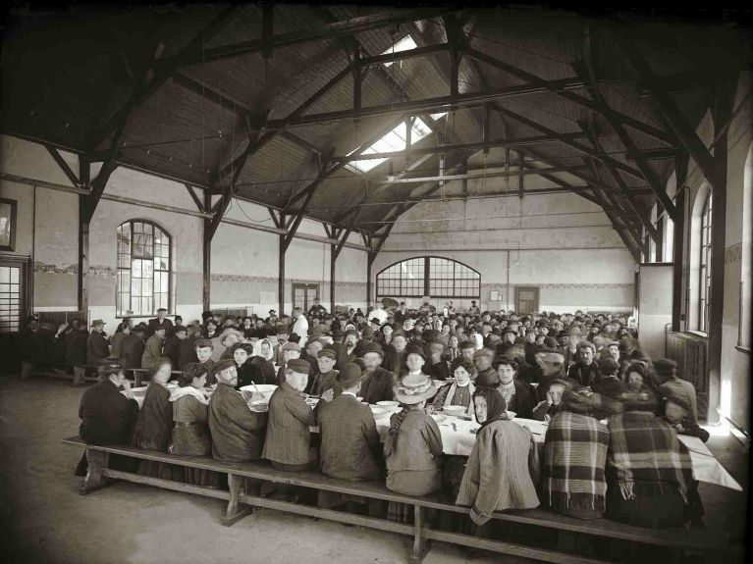
From Germany
Vital Records
Obituary or Gravestone
Naturalization Records
Passenger Lists
German emigrants wait in Hamburg for their ship passage.

Slide 8
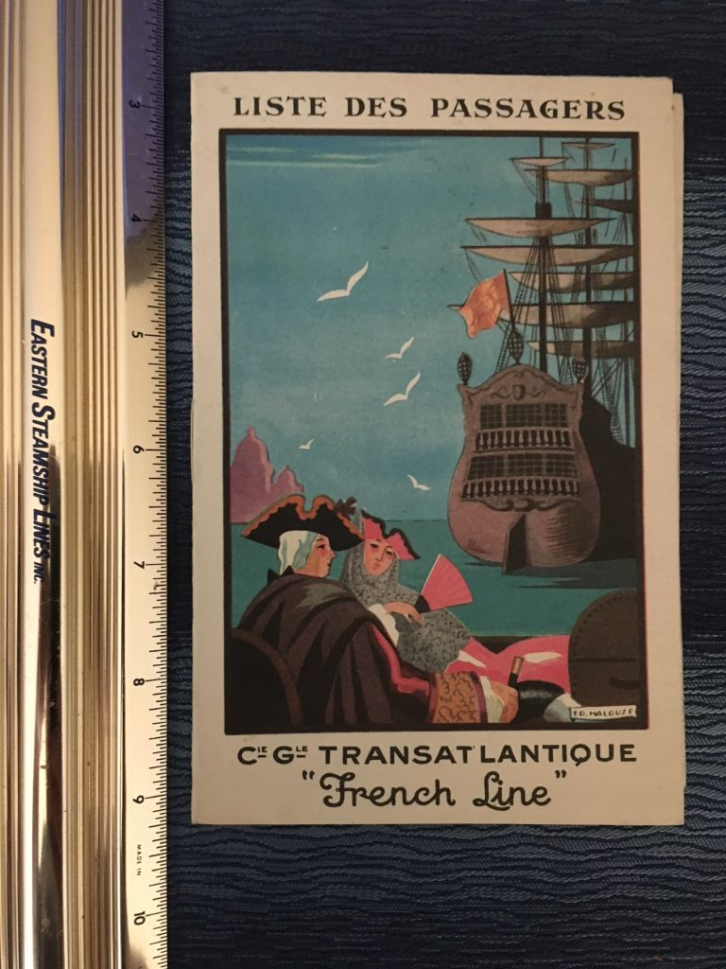
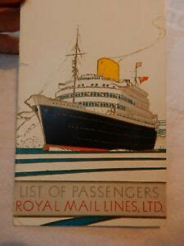
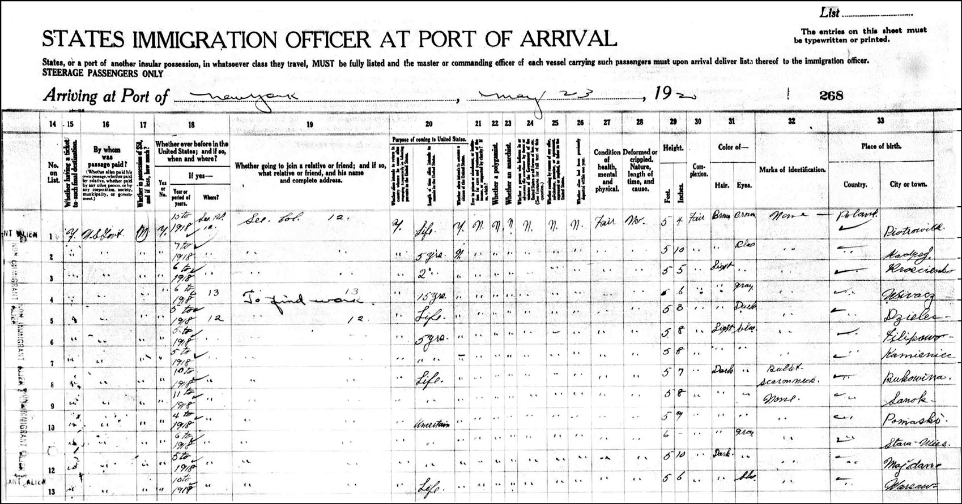
Passenger Lists
Lists prior to about 1800 are very limited
Common names: do not assume the first Jacob Weber you find is in your genealogy
Post 1820 US Passenger lists cover most of the Atlantic ports and are consistent from that point forward

Slide 9
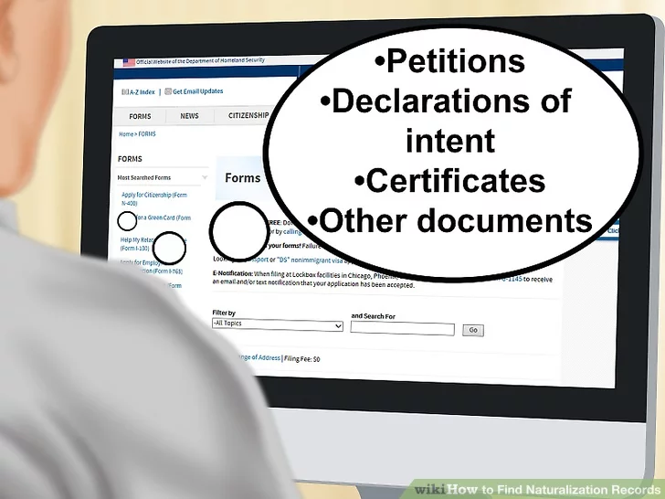
Naturalization Records
Are the “gold standards” listing the country of origin
Review the papers of the witnesses to learn if their origin in Germany is similar.
Are these witnesses Family, Associates, or Neighbors?

Slide 10
Vital Records
Birth Record lists the place of birth and parents of the child
Marriage Record lists the place of birth or one or both spouses and sometime their parents’ places of birth
Death Record lists the place of death of the deceased, sometimes their parents.

Slide 11
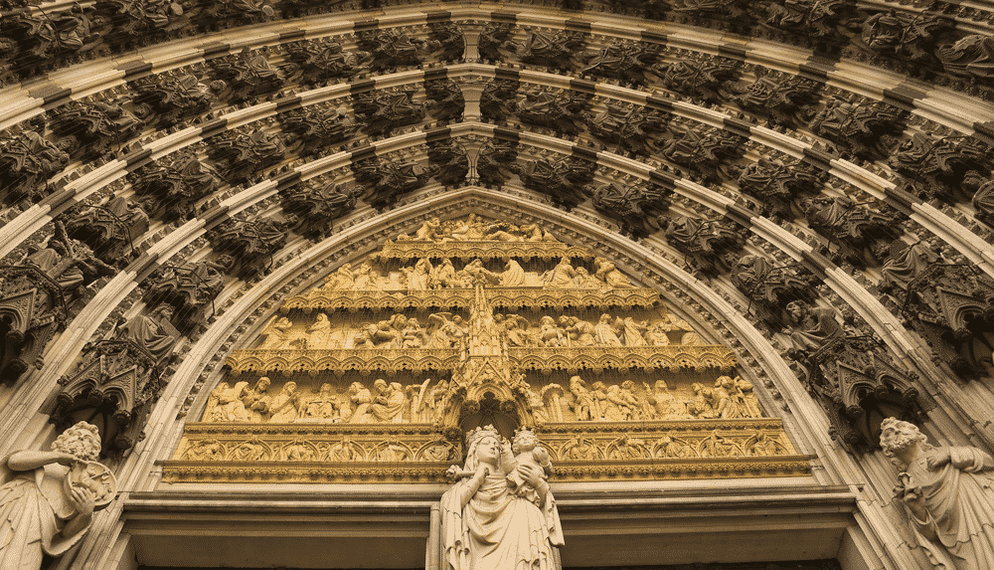
Parish Records
Baptisms-had to be recorded within 21 days after birth
Marriages-when, where and how
Confirmations-Sponsors can be family link clues
Deaths-attending physician sheds light on family medical conditions
Name of Undertaker
Burials-place of burial
Parish Records usually go back much further
than Civil Records

Slide 12
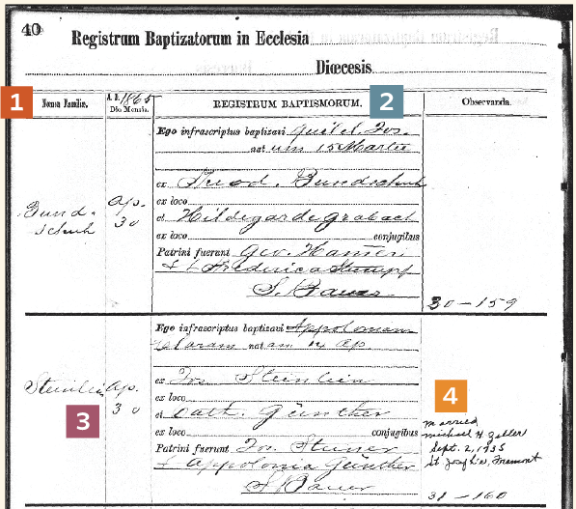
Baptisms
Name of Child
Birthplace-baptized in church of father or mother
Names of parents and their marriage
Watch for the Informant's qualifications
Date of Baptism is NOT the date of birth, many were recorded weeks or even months later.

Slide 13
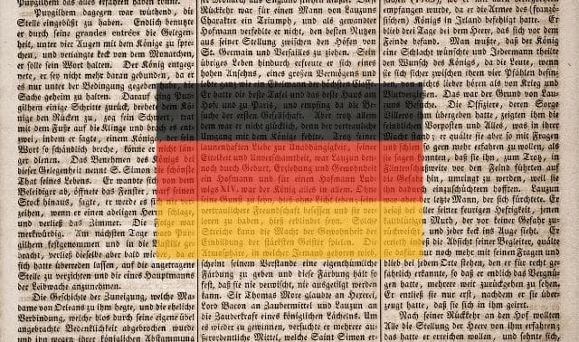
Marriages
Name, age, occupations of both bride and groom
Residences of both
Name and occupation of fathers of both groom and bride
Name and maiden name of mothers of groom and bride
Officiant and Witnesses
Banns are a proclamation to marry
May be recorded in two parishes (bride and groom)

Slide 14
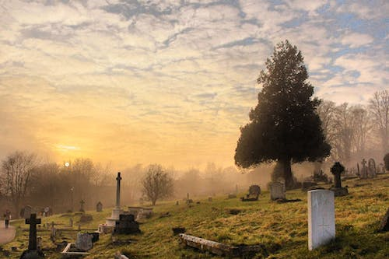
Burials
Often are more informative than Death Records
“Angels” or child’s death may lead you to their age at the time of death and ages of parents
Generally include the name of the deceased and date of interment

Slide 15
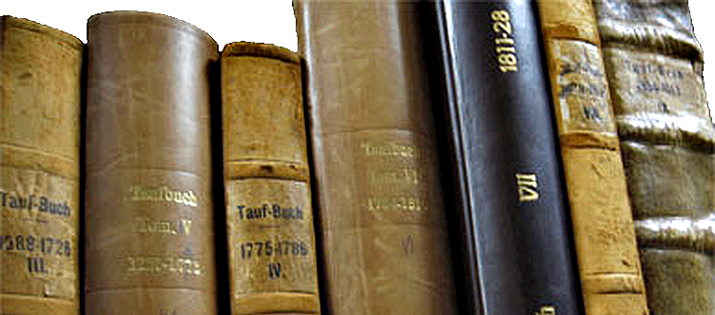
Roman Catholic
Many pre-1850 records are available
Parish priest
Diocese/archdiocese
Matricula

Slide 16
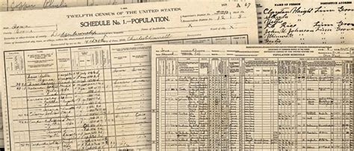
Census Records

Slide 17
Wills and Testaments

Slide 18
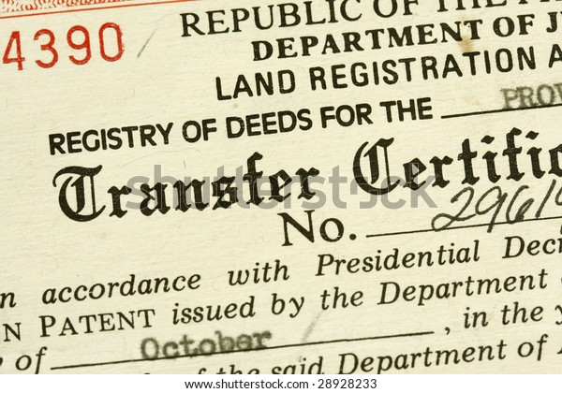
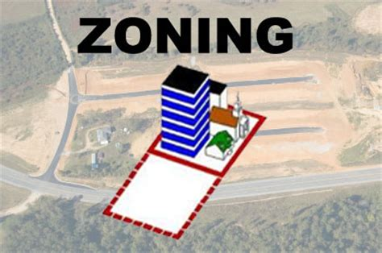
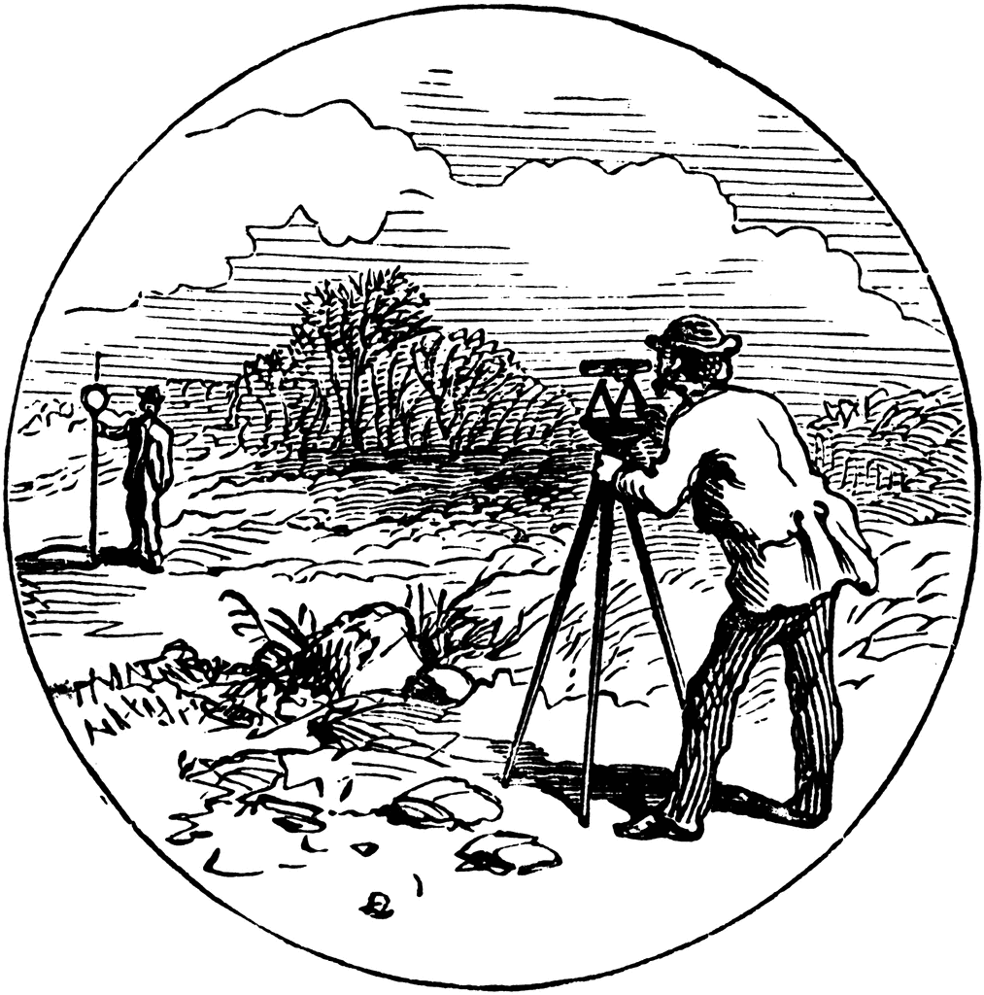
Land Records

Slide 19
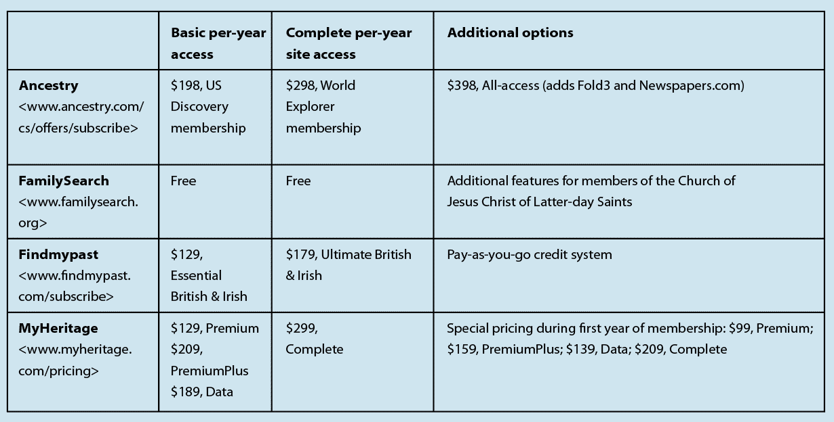
Websites
Website | RootsTech 2023 RootsTech 2023
Website | RootsTech 2023
Website | RootsTech 2023
Website | RootsTech 2023
Post RootsTech 2023

Slide 20
Finding Your Roots
Start with What We Know
Research the Online Databases
Attend Seminars and join Groups = Learn & Share!
Blood lines: DNA testing
Review History and Geography (carry maps)
Digitize Your Documents (download or scan yourself)
Backup your Files (paper and electronic)

Slide 21
Finding Your Own Roots-8 Tips
Reach out to relatives
Build a Family Tree
Search for compelling stories
Bring in DNA results
Collaborate with others
Dig deep for details
Fill in gaps with historical context
Create take-home mementos

Slide 22
Review
Confirm those oral family traditions using primary resources
Check US immigration resources and German resources
Passenger Lists
Naturalization Records
Review Parish Records
Review Civil Records
Review Census Records
Review Land and Probate Records
Connect with local genealogical societies

Slide 23
Next Month
Always check the website: http://www.kolpingcincinnati.com/Genealogy/Genealogy.html
April 16: Photographic Forensics

Slide 24
Research
Happy Hunting!

